Slide 1
CSIS 486-Cyber Security Capstone Spring 2022
AI/ML Anomaly Detection and Cyber Treat Intelligence
Team One
-
Riley Dorough
Kayla Echols
Julia Wilkins
Brett Wolff

Slide 2
Overview
Project Scope – Kayla
Project Schedule – Kayla
Data Historian Overview – Kayla
OT Data Pipeline – Julia
IT Data Pipeline – Riley
Lessons Learned – Team 1
Conclusion – Brett

Slide 3
Project Scope
Implement an Artificial Intelligence model by creating algorithms and using a Knime pipeline to provide relevant data points including:
Operational Technology (OT) data
Information Technology (IT) data
Using these data points to provide predictive Cyber Threat Intelligence (CTI) with the goal of improving the effectiveness of OT CTI products
Demonstrate real time predictive data from the provided data products

Slide 4
Project Schedule
Phase 1: Designed original pipelines to get presentable and usable data
AI/ML research and Initial Test Case Demonstration and Design
Network Architecture Reports: Team Network topology map
Phase 2: Added more pipelines using various data
Initial implementation operations
Phase 3: Flagged data anomalies using various nodes in the pipeline
AI/ML CTI Product Demonstration versions 1 and 2
Phase 4: Connected to MS SQL database to get live data into Knime
Real Time AI and ML Processing for Initial Cyber Threat Intelligence Validation Testing

Slide 5
Data Historian Overview
Utilized OPTO22 datalink and control basic
Human Machine Interface (HMI) on PAC Display Runtime Basic
Transfers data to MS SQL
Visualizes data with Grafana
Notes:
MS SQL 2012

Slide 6
OT Data Pipeline
Input
Manipulation
Classification
Visualization
Calculations
Anomaly Flagging
Reporting

Slide 7
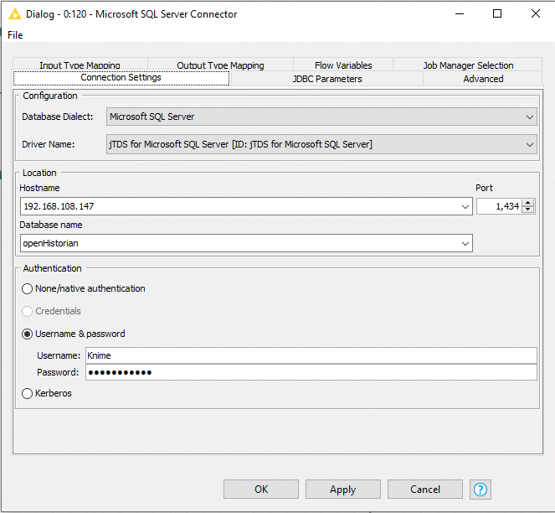
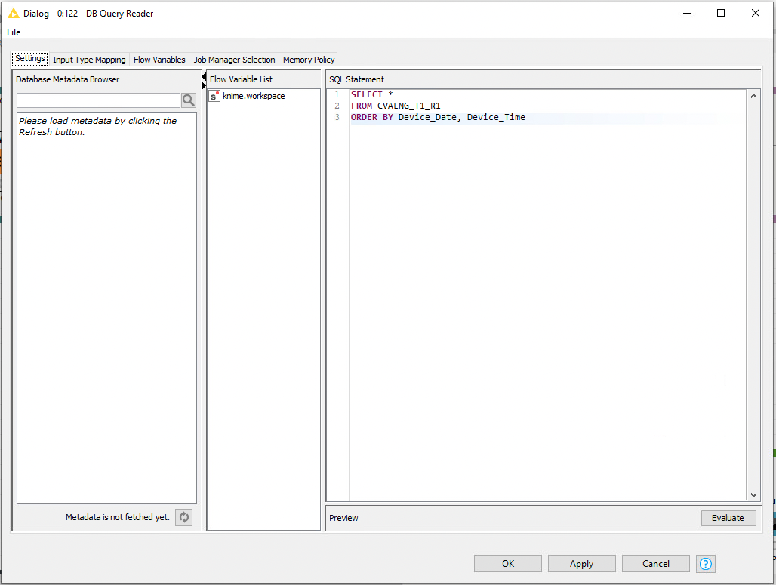
OT Data Pipeline
Data Input
Pulled Directly from our data historian

Slide 8
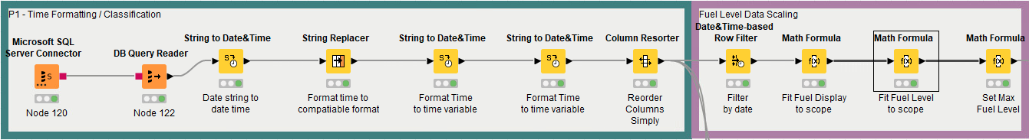
OT Data Pipeline
Data Manipulation

Slide 9
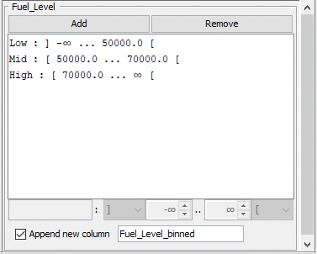
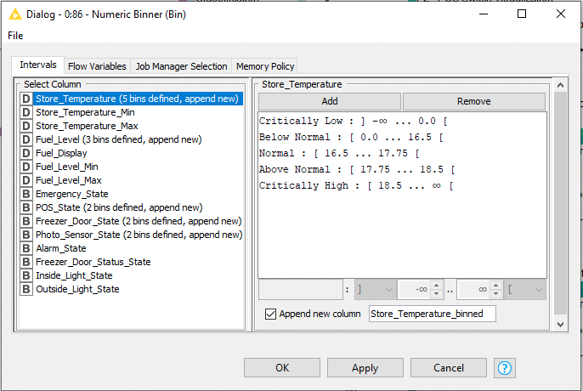
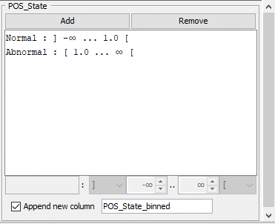
OT Data Pipeline
Data Classification
Allows for us to set the boundaries by which our data is classified giving a 100% accuracy rating

Slide 10
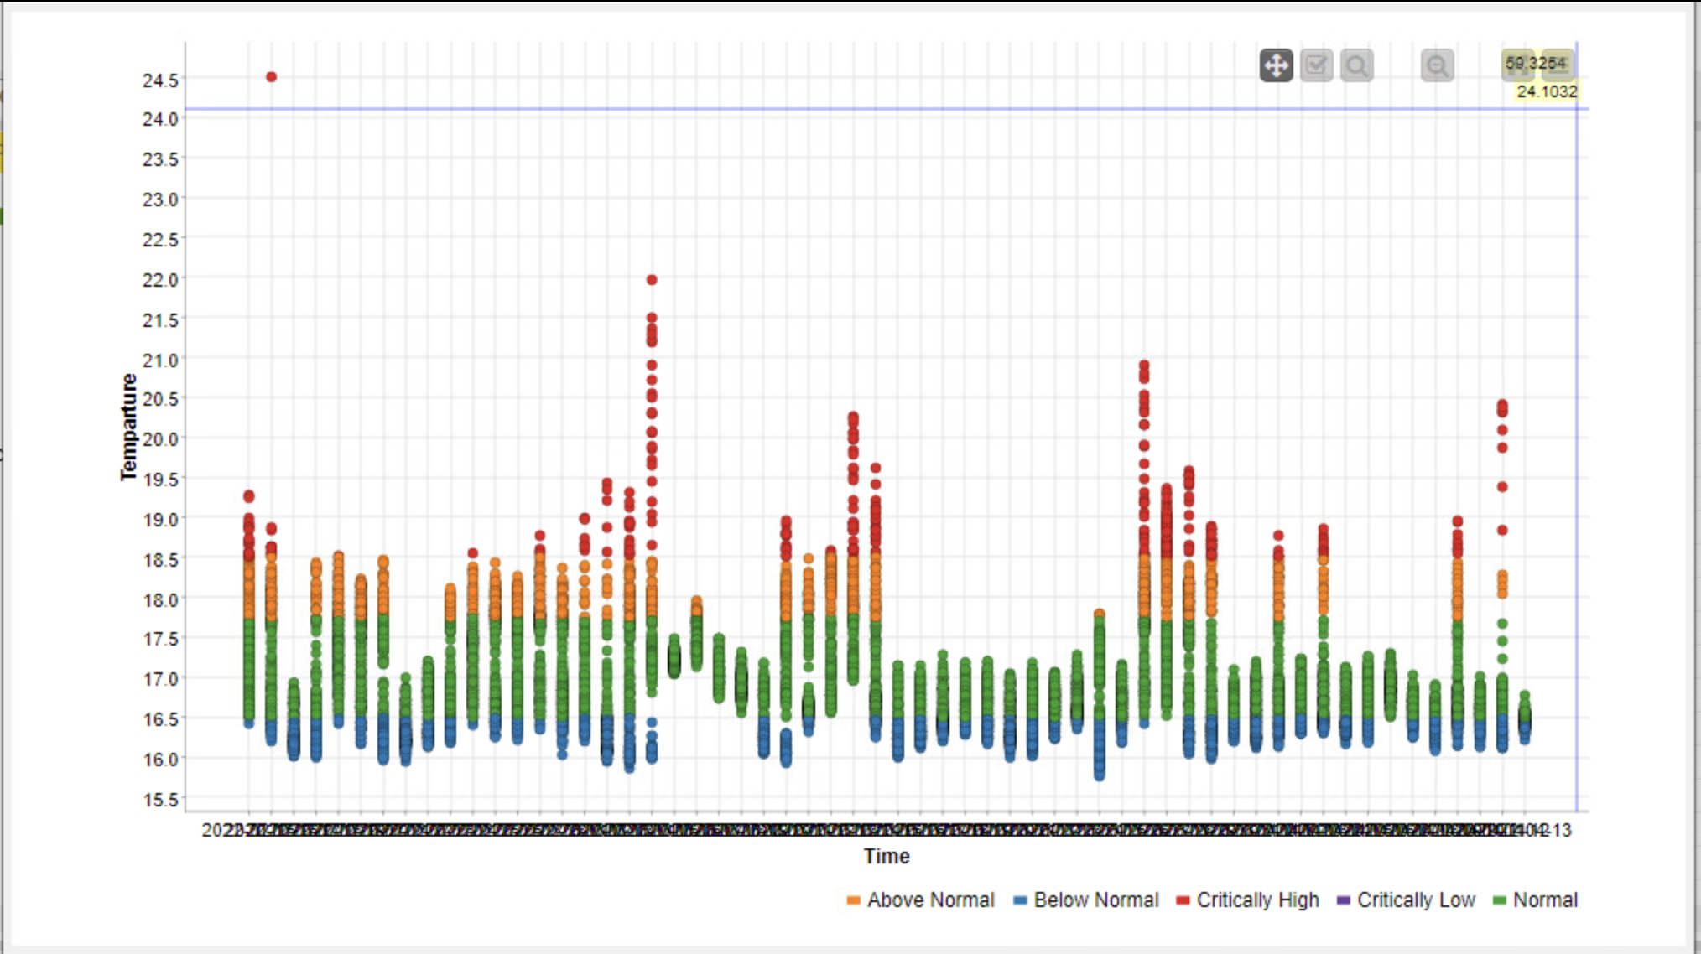
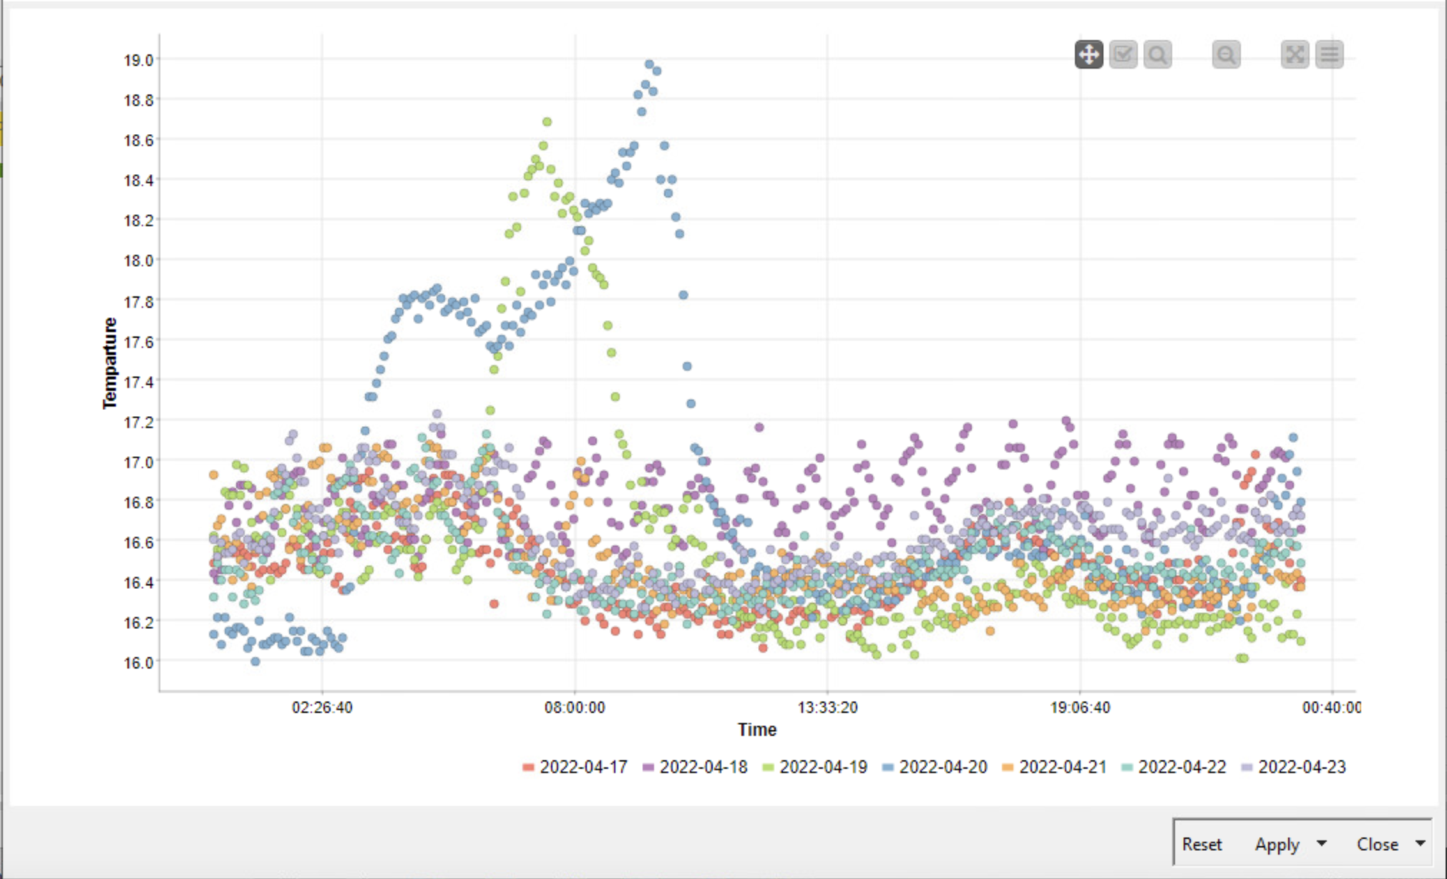
OT Data Pipeline
Data Visualization
Data graphed by day vs Data from one week graphed over a 24hr time period

Slide 11
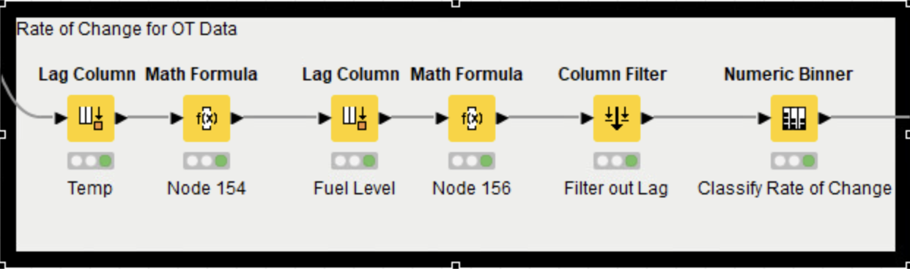
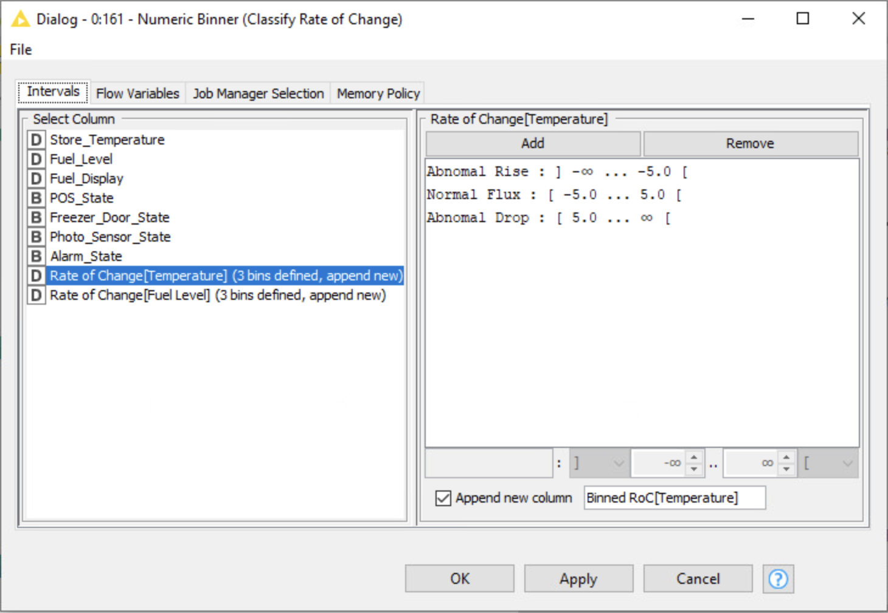
OT Data Pipeline
Additional Calculations
Rate of Change Calculations for detecting rapid rise or fall of values such as temperature or fuel level

Slide 12
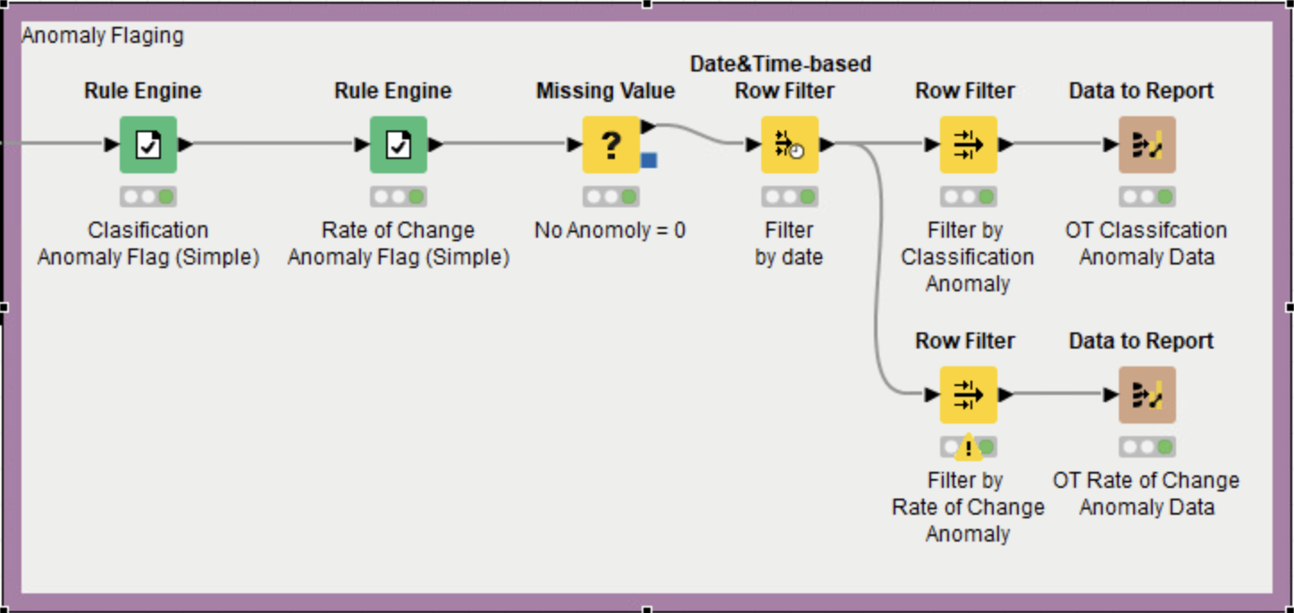
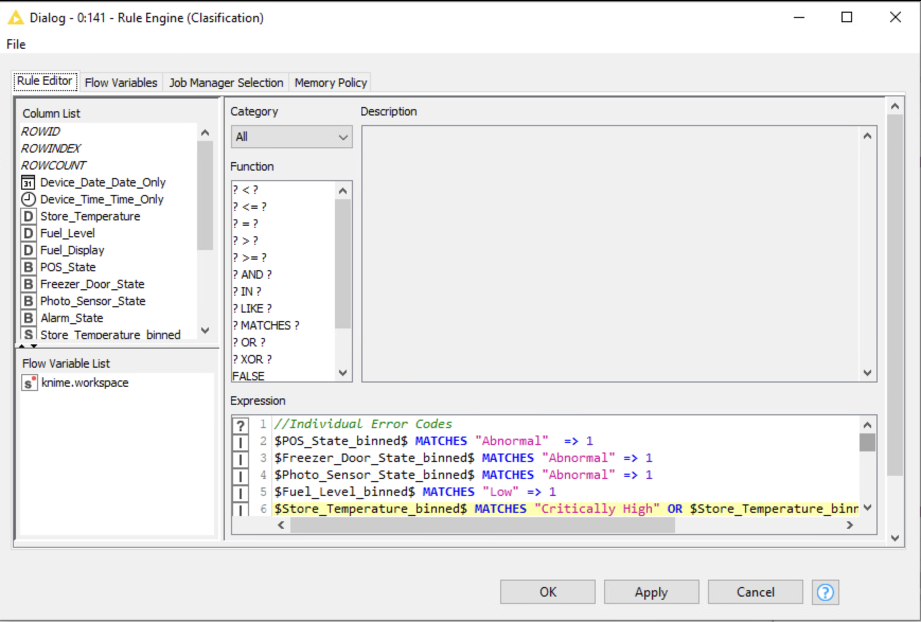
OT Data Pipeline
Anomaly Flagging
Whenever data is binned into an anomalous bin that row is flagged

Slide 13
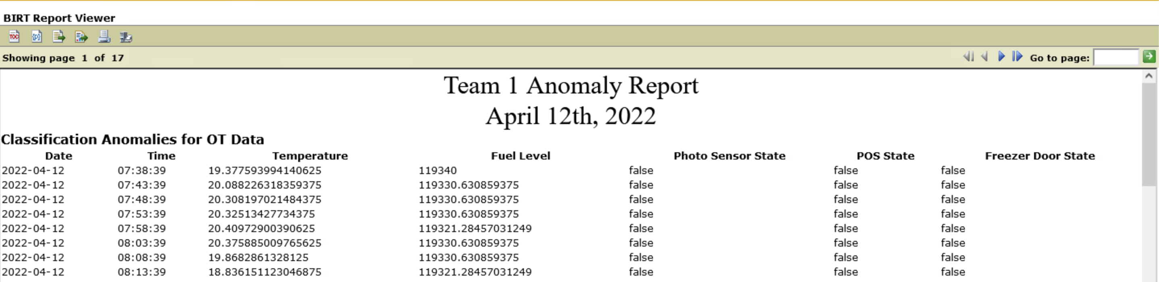
OT Data Pipeline
Reporting
Anomalies are flagged, filtered by date, and then sent to reports

Slide 14
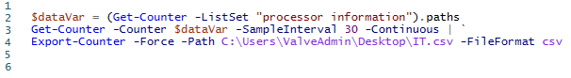
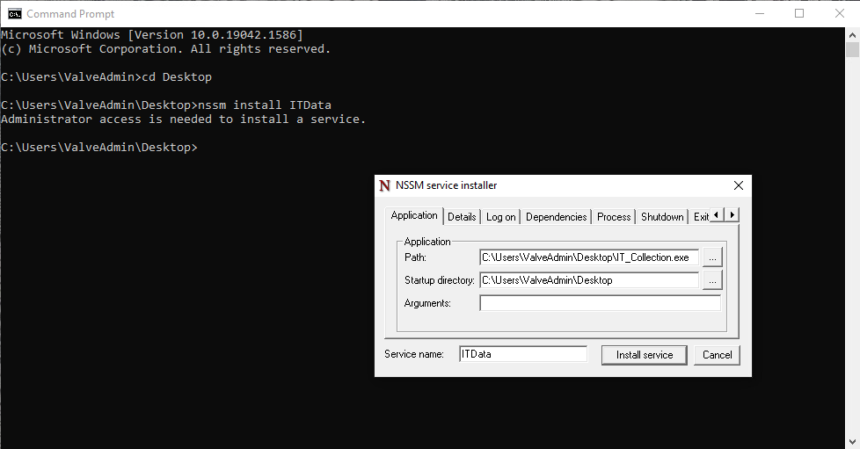
IT Data Pipeline
IT Data Collection
2375 Default system metrics available
Many have sub classes of additional data
Remote devices need to be included in the Phase 1 data historian
Near Real Time achieved for IT data through NSSM

Slide 15
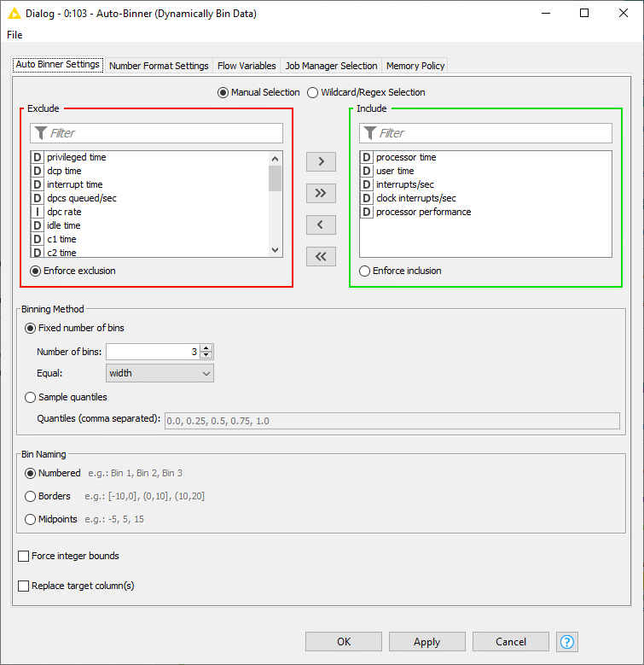
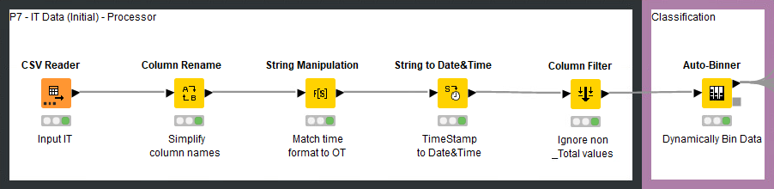
IT Data Pipeline
Prepare IT Data
Read from near real time CSV
Designed to operate on data/ data formats
Sent to Auto-Binner to assign classification
3 bin of equal distance
Lowest data value to highest

Slide 16
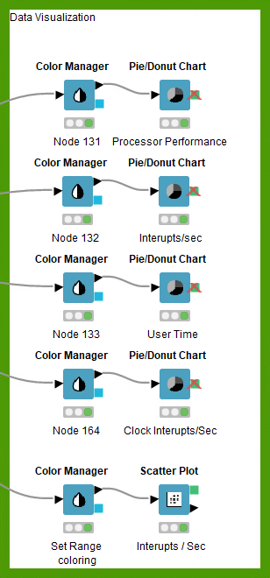
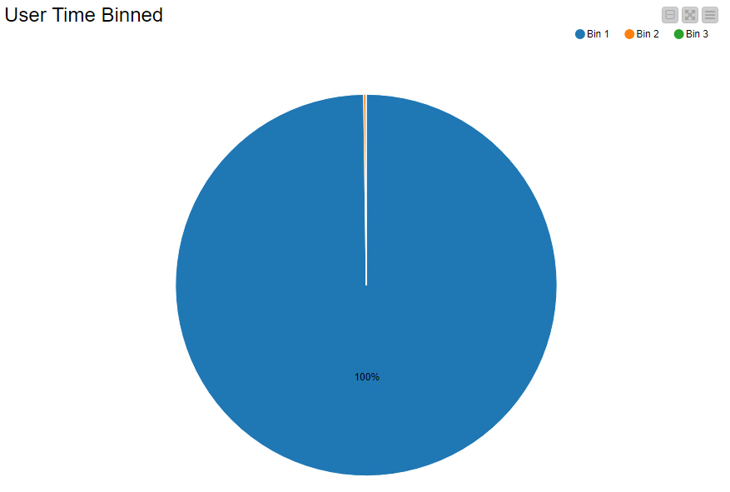
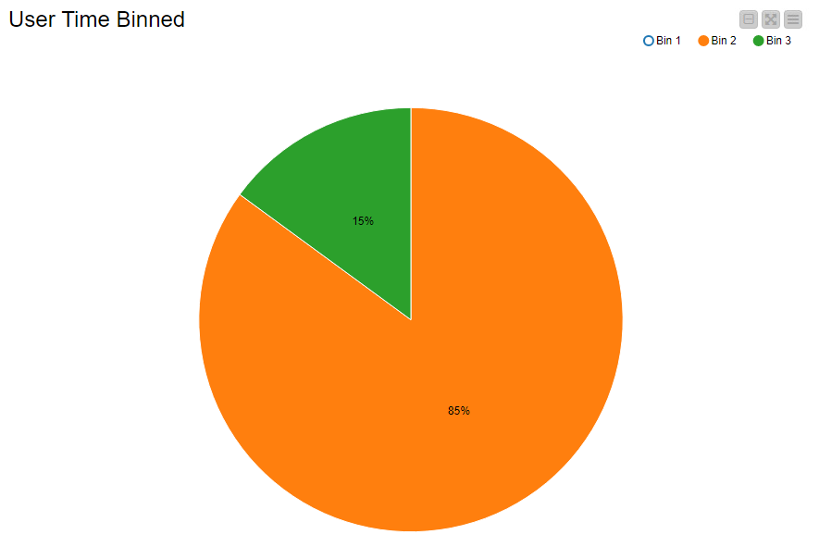
IT Data Pipeline
Direct Visualization of Classification
Data is output into charts and graphs from the Auto Binner
With nominal data
Without nominal data

Slide 17
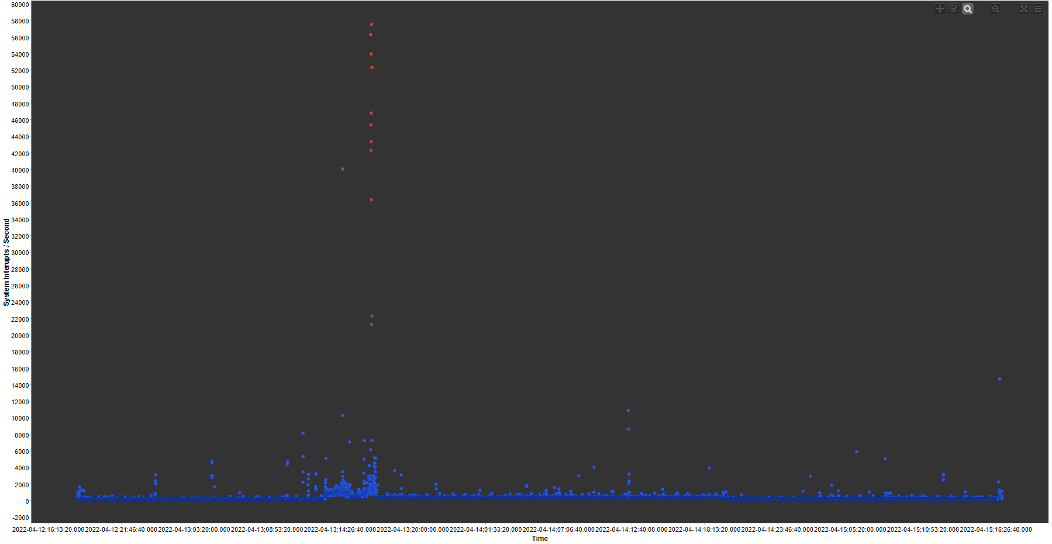
IT Data Pipeline
Direct Visualization of Classification
Data is output into charts and graphs from the Auto Binner
System Interrupts/Second

Slide 18
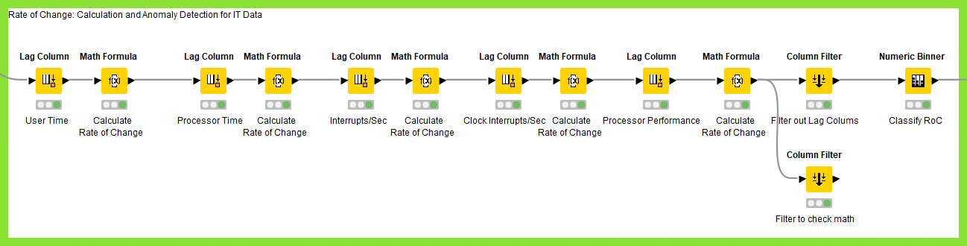
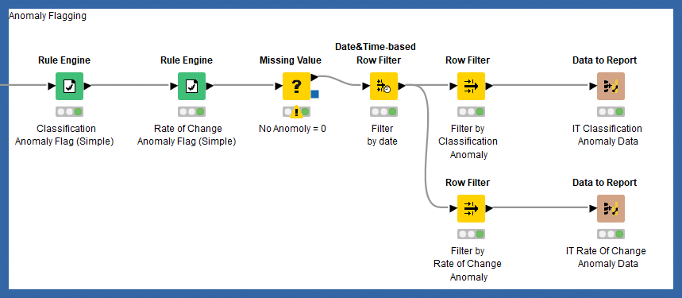
IT Data Pipeline
Rate of Change Classification & Report Documentation
Same as OT Data; Includes 5 Data Sets so far
Classified rate of change + filtering of unused data
Sent to rule engines to flag rows of data which contain anomalies
Filtered and sent to the final report

Slide 19
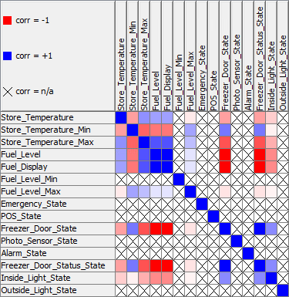
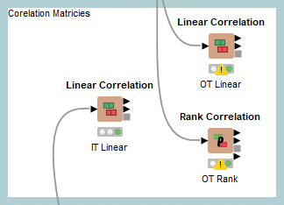
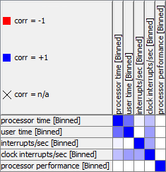
IT Data Pipeline
Data Correlation – Initial Progress
Correlation Matrixes show how likely data is to line up with other data fields

Slide 20
Lessons Learned & Feedback
Learned how to use nodes in Knime to create pipelines to gain useful data and flag anomalies. Learned how to get live data into Knime
Learned how to best classify data and use those classification to detect anomalies
Learned the architecture of Windows as it applies to system information Creating services to operate with unknown data to find use for the information
Learned more about packet logging and how to refine what internet traffic is being recorded
Notes:
Not roadblocks but what we learned and how we came up with an effective design. A design is effective when the client accepts it. Focus on the value of your team. What the team focus was.

Slide 21
Conclusions
Accomplishments
Data Classification
Anomaly Detection
Near Real Time - Live Data for both OT and IT
Demo available upon request

Slide 22
Questions?

Slide 23

Secret Slides
01010100 01100101 01100001 01101101 00100000 00110001

